Slide 1
Digital PSAT Exam 2023 West Broward High School

Slide 2
An Overview of the New Digital SAT
The digital SAT, administered by the College Board for university admission, differs from the paper-pencil format, offering a more flexible, secure, and relevant test experience.
The first administration of the digital version of the PSAT is currently underway.
The first administration of the digital SAT will be in March of 2024.
In November 2021, College Board piloted the digital SAT in the U.S. and internationally; 80% of students responded that they found it to be less stressful and 100% of educators reported having a positive experience.

Slide 3
What changes can we expect on the new digital PSAT?
Students will take the test on a laptop or a tablet where they already do much of their learning.
The test will be shorter, changing from three to two hours.
Reading passages will be shorter, and math questions will be less wordy.
Students will be able to use calculators in the entire Math section.
Scores will be delivered in days instead of weeks.

Slide 4
What is not changing on the digital PSAT?
The test will remain on a 1,600 scale.
Exams still need to be taken in a testing center, and students cannot take the exam at home.
There will be a proctor to administer the test at the exam center.
Students taking the SAT Suite will continue to connect to scholarships and the College Board National Recognition Programs.

Slide 5
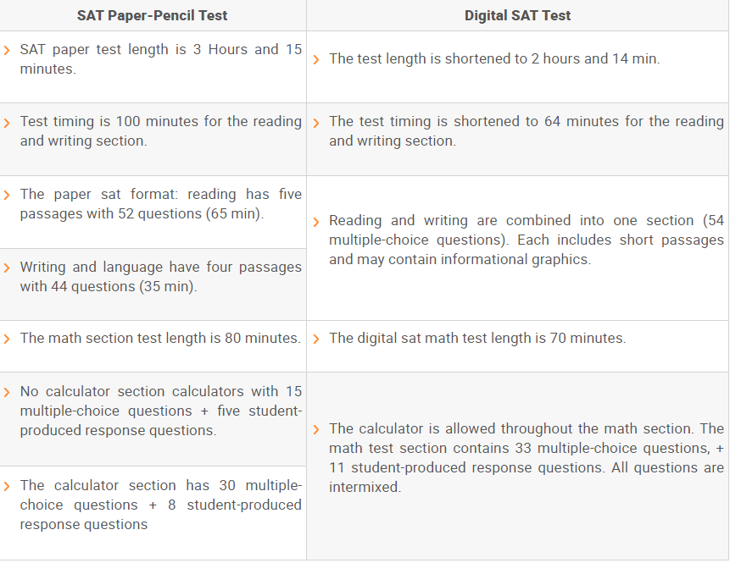
Differences Between the New Digital PSAT and the Paper Version of the PSAT

Slide 6
Who at West Broward will be impacted by the new digital format?
All current 9th graders taking the PSAT on October 12th
All current 10th graders taking the PSAT on October 12th
11th graders who paid for the PSAT and will be taking the exam on October 12th
12th graders who have not met the math testing requirement and who will be taking the PSAT on October 10th
Any student taking a PSAT or SAT in March of 2024 or any testing date thereafter

Slide 7
How can students best prepare for the new digital version of the PSAT?
Students should take advantage of the following online resources:
www.Collegeboard.org
www.khanacademy.org
These two resources will be discussed further in the slides that follow.

Slide 8
How do I access College Board’s resources?
Go to Collegeboard.org
Log in to account or create account for first time users
Go to My SAT
Go to Black box on top left-hand corner and select the arrow
Select SAT
Select Digital SAT on top menu
Select Digital SAT Home on the drop-down menu
Scroll down until you see Bluebook App and Device Information
Download Bluebook (View next slide to see Bluebook resources.)

Slide 9
Bluebook Resources
Test Preview
2 online PSATs (one 8/9 PSAT and one PSAT/NMSQT)
4 printable SAT tests and accompanying answer keys
You will find these printed tests on a link at the bottom of the page once you select in the drop-down menu.
Then select explore full length linear (nonadaptive) practice tests.
Scroll down to Resources and you will find the four paper tests and answer keys.
Various practice sessions

Slide 10
Khan Academy Resources
Go to Khanacademy.org
Sign in or create an account
Go to Courses on top left menu
Go to third column and click on Digital SAT
Answer the two questions – Select US and year 2024
Click on Start Practicing
There you will have access to the platform with an abundant amount of practice at all levels for math, reading, and writing.
Three levels
Foundations – basic
Medium
Advanced

Slide 11
Reminders for a Successful Testing Day
Know the date, time, and location of your test. Ask your teachers!
Bring your own approved calculator.
Get a good night’s rest and eat a proper breakfast
KNOW THE FORMAT OF THE NEW DIGITAL TEST!!!!!!!!

Slide 12
One last very important reminder about testing day, October 12th.
There will be NO early releases. The normal school day will resume after testing, and all students are expected to be in attendance.
It is imperative that all understand and honor this request so that we are able to maintain the safety and security of the campus. The front office is not equipped to handle large volumes of parents requesting to sign their child out early.
Students who are NOT testing may be placed in the cafeteria during the first two periods.
THANK YOU FOR YOUR COOPERATION!

